Slide 1
ACC.24 Integrating Complex Data Into Clinical Practice
Insights From the PIONEER AF-PCI Trial
Manesh R. Patel, MD
Richard S. Stack Distinguished Professor, Chief, Division of Cardiology
Co-Director, Duke Heart Center, Duke Clinical Research Institute
Duke University, Durham, NC

Slide 2
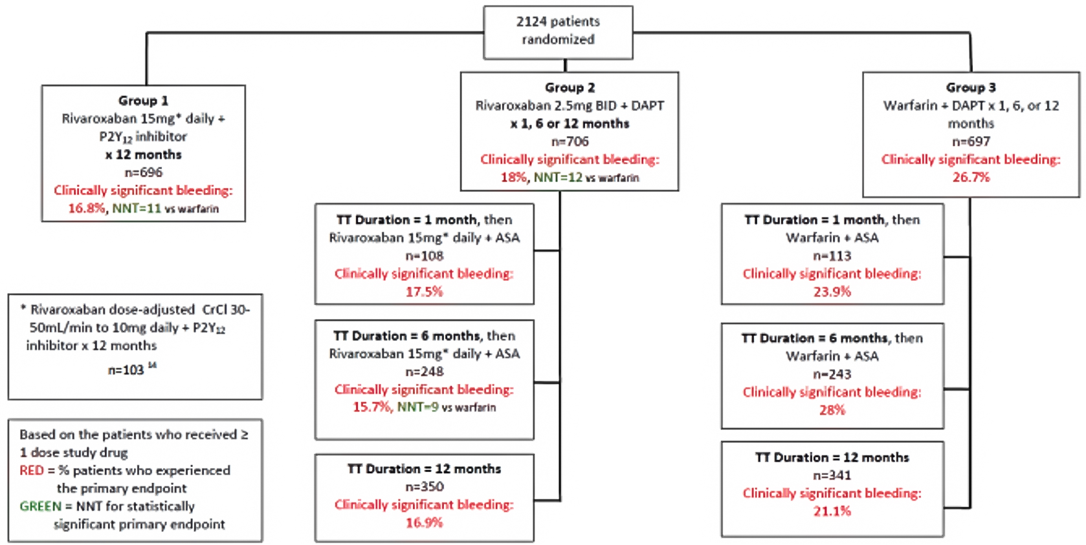
PlONEER AF-PCI: Treatment Arms With Durations of Therapy and Primary Endpoints
ELDERLY PATIENTS

Slide 3
PIONEER AF-PCI: Methods
Phase 3 international study
Randomized patients to either rivaroxaban or warfarin-based antithrombotic regimens
Key endpoints included
  Net adverse clinical event (NACE; composite of clinically significant bleeding [CSB] or major adverse cardiovascular event [MACE])
  Rehospitalization and components

Slide 4
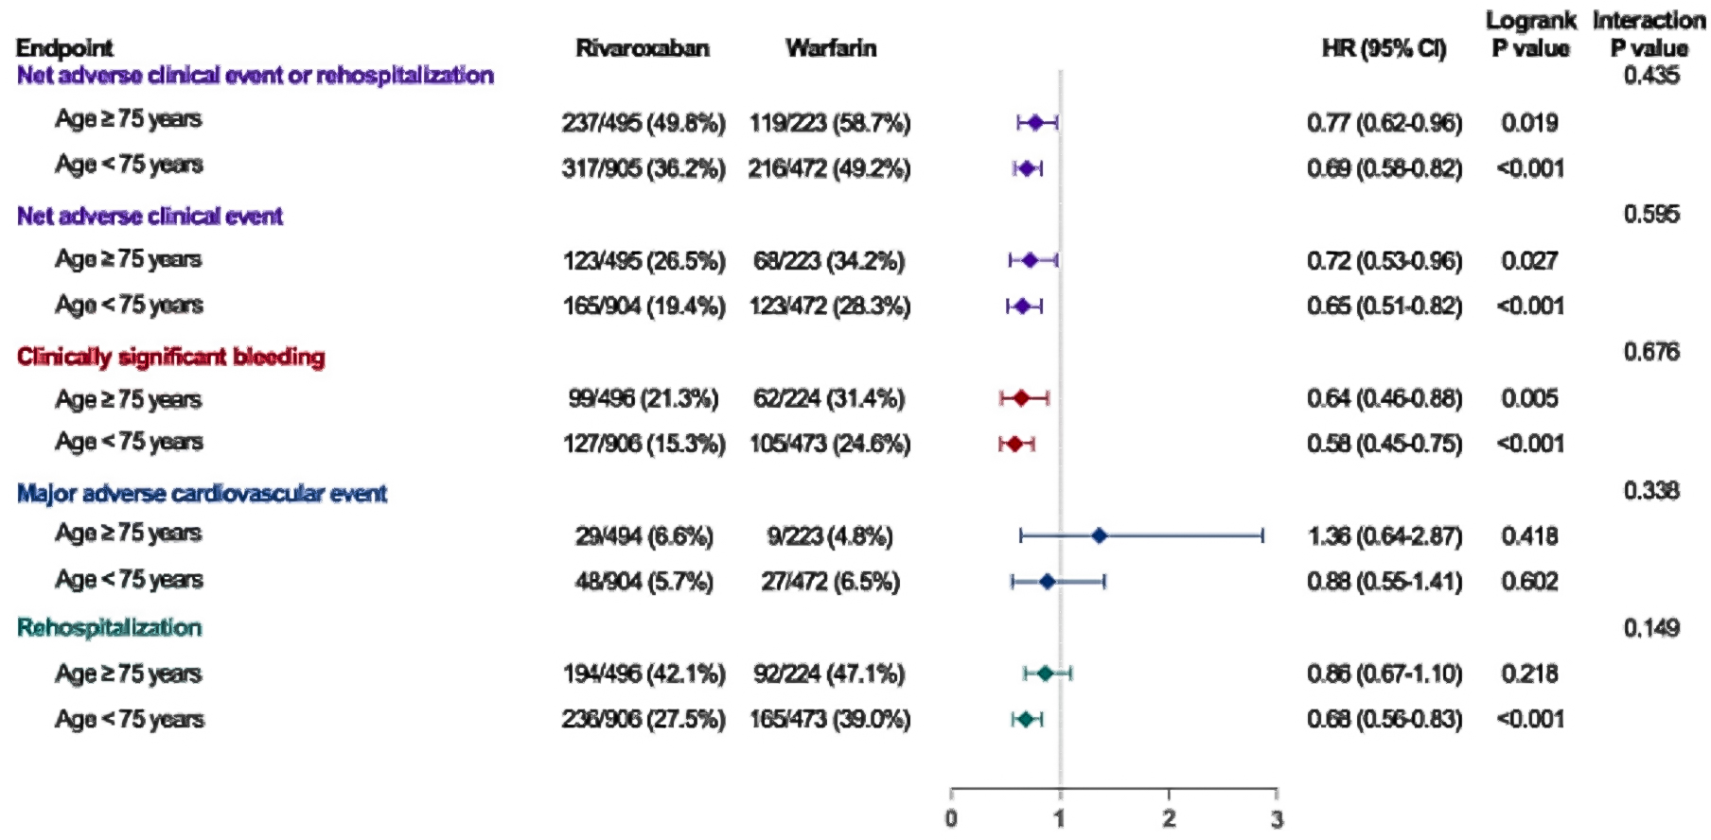
PlONEER AF-PCI: Interaction Between Age Group and the Treatment Effect

Slide 5
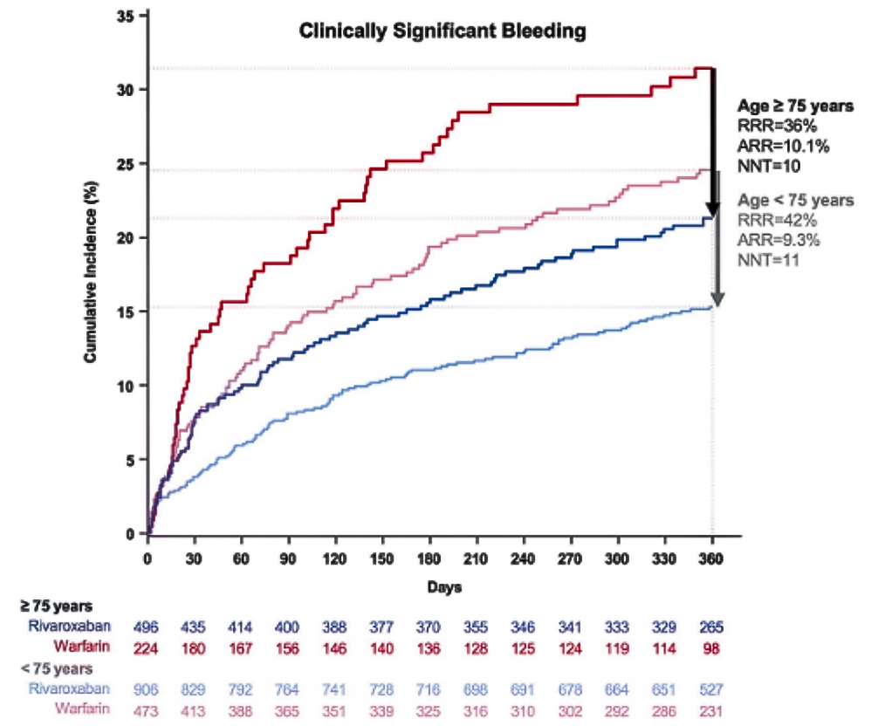
PlONEER AF-PCI: Reduction of Clinically Significant Bleeding by Rivatoxaban Stratified by Age Group

Slide 6
PIONEER AF-PCI: Take-Home Message
Both in elderly and non-elderly patients with AF undergoing PCI, rivaroxaban was associated with a reduced risk of NACE or rehospitalization compared to warfarin, primarily driven by a lower risk of clinically significant bleeding (CSB)
Effect of modification by age was insignificant across all endpoints

