Slide 1
ACC.24 Integrating Complex Data Into Clinical Practice
Insights From VOYAGER PAD, Part 1
Marc Bonaca, MD
Executive Director, CPC Clinical Research
Professor of Medicine, Cardiology & Vascular Medicine
Director of Vascular Research, University of Colorado School of Medicine
Aurora, CO

Slide 2
VOYAGER PAD
Over 6,000 patients with symptomatic peripheral arterial disease (PAD)
Randomized patients to rivaroxaban or placebo and a background of aspirin
Rivaroxaban reduced major adverse limb events and, although bleeding increased, there was an overall net benefit

Slide 3
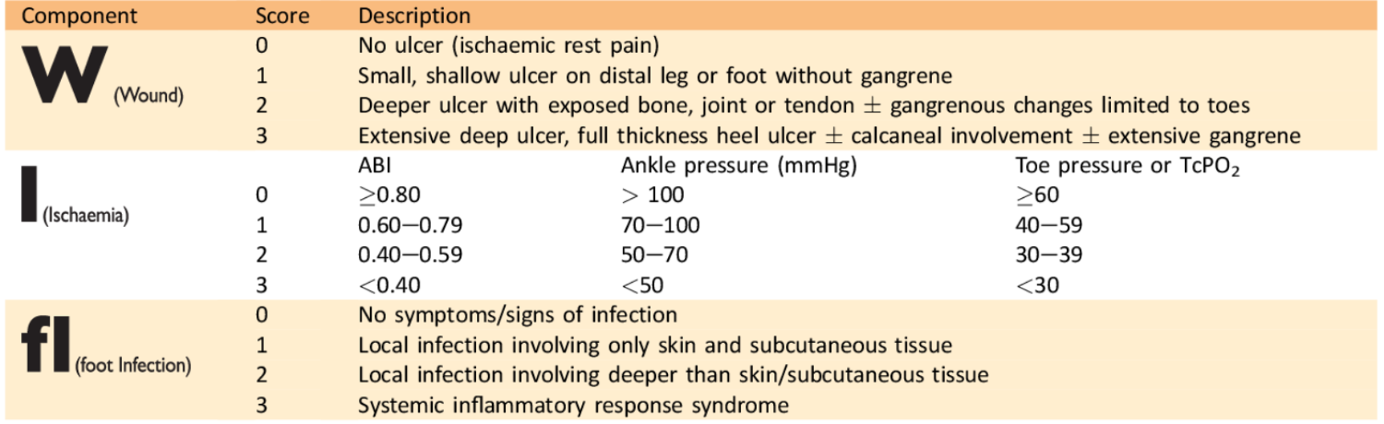
WIfI – Wound Ischemia foot Infection

Slide 4
Incidence of All Amputations by WIfI Score at 3 Years
P_{trend} < 0.001

Slide 5
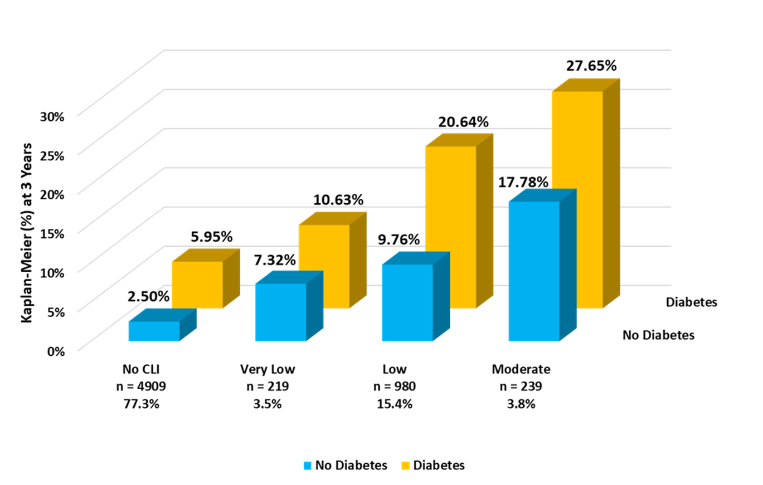
Incidence of Amputations at 3 Years by WifI in Patients With and Without Diabetes Mellitus

Slide 6
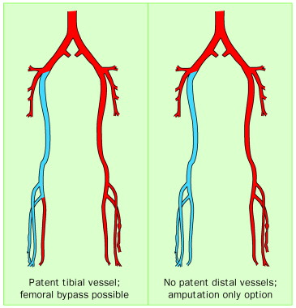
VOYAGER PAD Angiographic Core Lab
Anatomic and Flow Characteristics Across 16 Anatomic Segments From 2,646 Angiograms
Adjudicated MACE and MALE outcomes and PROs
(association with anatomy)
1. Infra-renal abdominal aorta
2. Common iliac
3. External iliac
Cross-sectional Analyses
4. Common femoral
5. Profunda femoral
6. Superficial femoral
28 months’ median follow-up
Severity of stenosis
Length of Disease
Calcification
Prior stenting or bypass
Thrombus
Aneurysm
Revascularization
7. Popliteal 1
8. Popliteal 2
9. Popliteal 3
PAD characteristics (Rutherford Category, ABI, CLTI) association
with anatomic features
Anterior tibial
Tibioperoneal trunk
Peroneal
Posterior tibial
Clinical characteristics (age, sex, diabetes, smoking, CKD) association with anatomic features
Lateral plantar
Dorsalis pedis
Pedal arch

Slide 7
VOYAGER PAD Angiographic Core Lab: Analysis
VOYAGER PAD
6,564 randomized participants
Non-Core Angiographic Core Lab
4,888 participants
Angiographic Core Lab
1,666 participants with angiograms
Excluded From BKD Core Lab Analysis
263 participants with angiograms that did not visualize below-knee
BKD Core Lab Analysis
1,403 participants with angiograms visualizing below knee
No Below-Knee Disease
N = 564
Below-Knee Disease
N = 839

Slide 8
Multivariate Analysis for the Association of BKD Disease and Cardiovascular Outcomes
HR* (95% CI)
1.06 (0.70-1.43)
Death
MACE
MALE
Major Amputation
ALI
Death + MALE
Major and minor amputation
0.99 (0.67-1.31)
1.65 (1.22-2.08)
2.33 (1.63-3.02)
1.54 (1.01-2.03)
1.29 (0.98-1.60)
1.99 (1.57-2.41)
Years

Slide 9
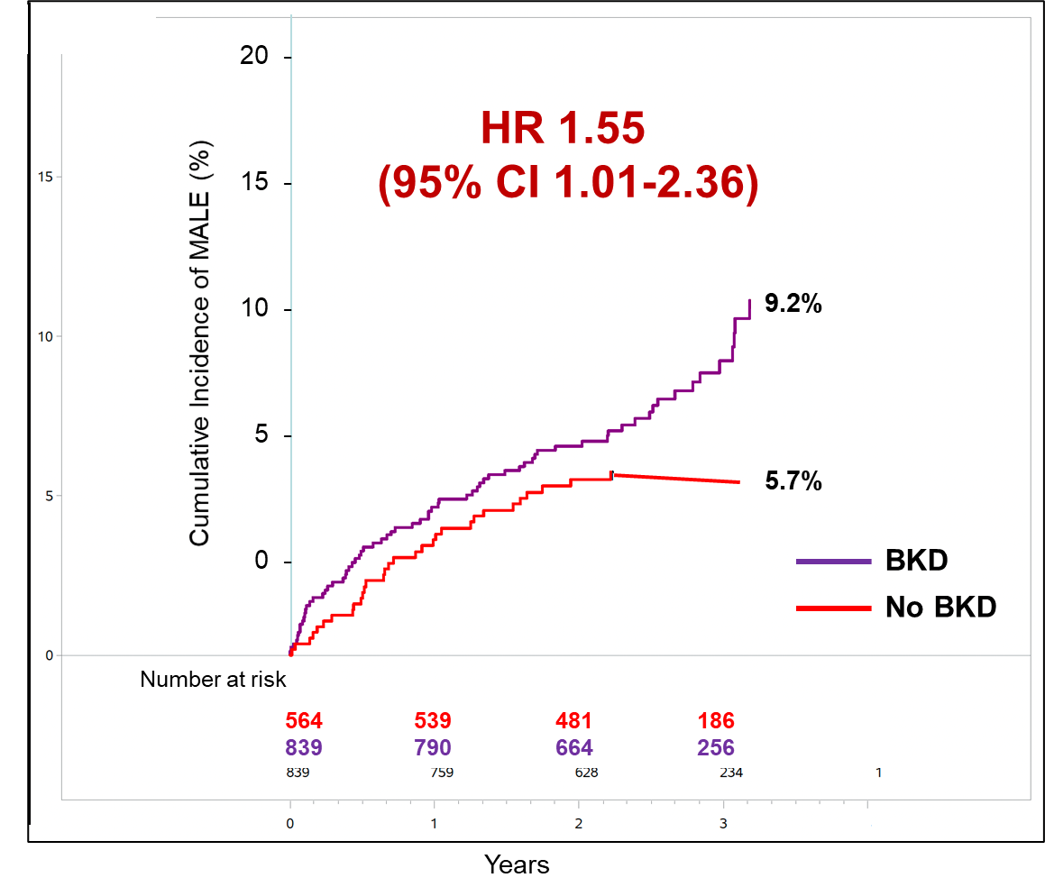
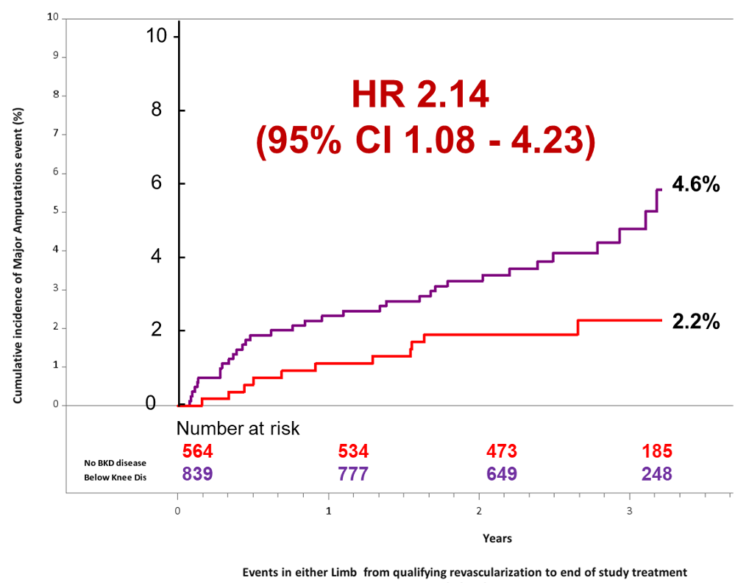
VOYAGER PAD Angiographic Core Lab: Results

Slide 10
Conclusions
Patients with BKD were older and had more comorbidities overall but did not have more diabetes
Prevalence of BKD is higher than “no BKD” in higher Rutherford categories and those with a history of CLTI
Patients with BKD are at increased risk of MALE and had numerically higher rates of mortality and MACE compared to those without BKD
The anatomic pattern of BKD can be used to risk stratify the risk of patients with PAD
Stratifying amputation risk
  Rutherford significantly associated with future amputation risk even after successful revascularization
  WIfI associated with amputation risk; however, when stratified by diabetes mellitus, risk is increased across categories
  A novel DM-WIfI score appears to better risk stratify suggesting that future iterations of WIfI should include diabetes mellitus as a risk factor for amputation

