Slide 1
ACC.24 Integrating Complex Data Into Clinical Practice
Insights From VOYAGER PAD, Part 2
Marc Bonaca, MD
Executive Director, CPC Clinical Research
Professor of Medicine, Cardiology & Vascular Medicine
Director of Vascular Research, University of Colorado School of Medicine
Aurora, CO

Slide 2
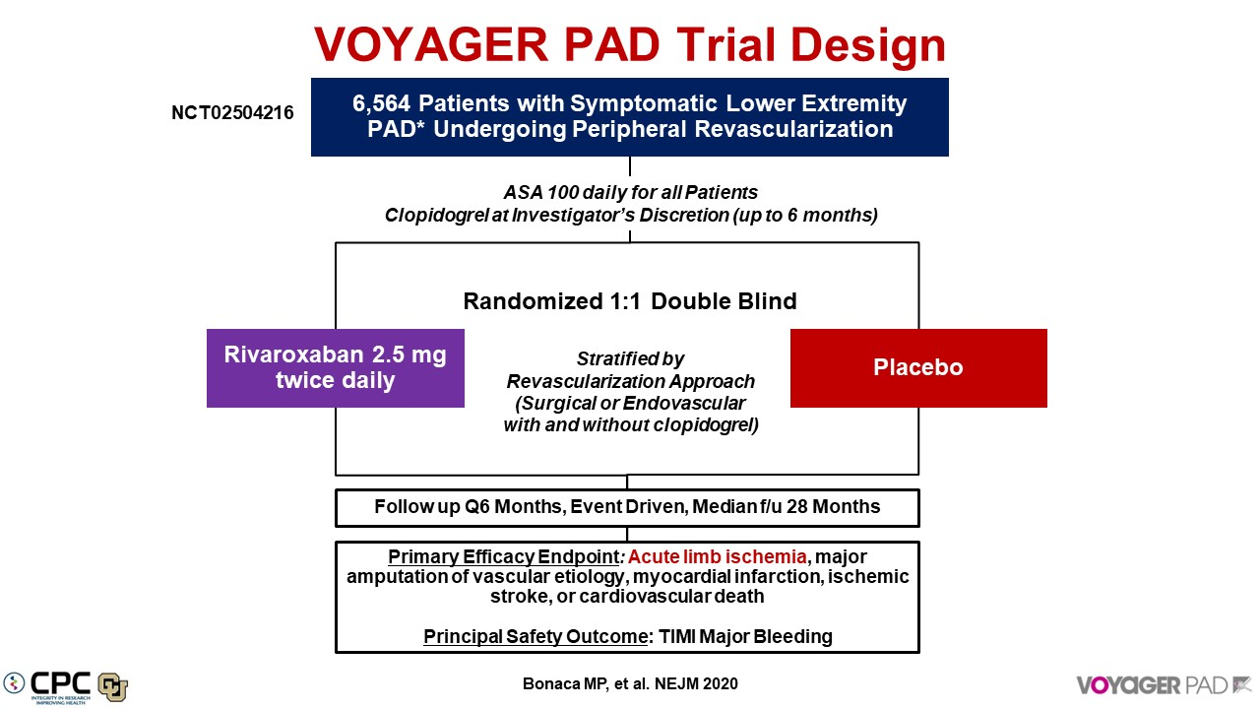
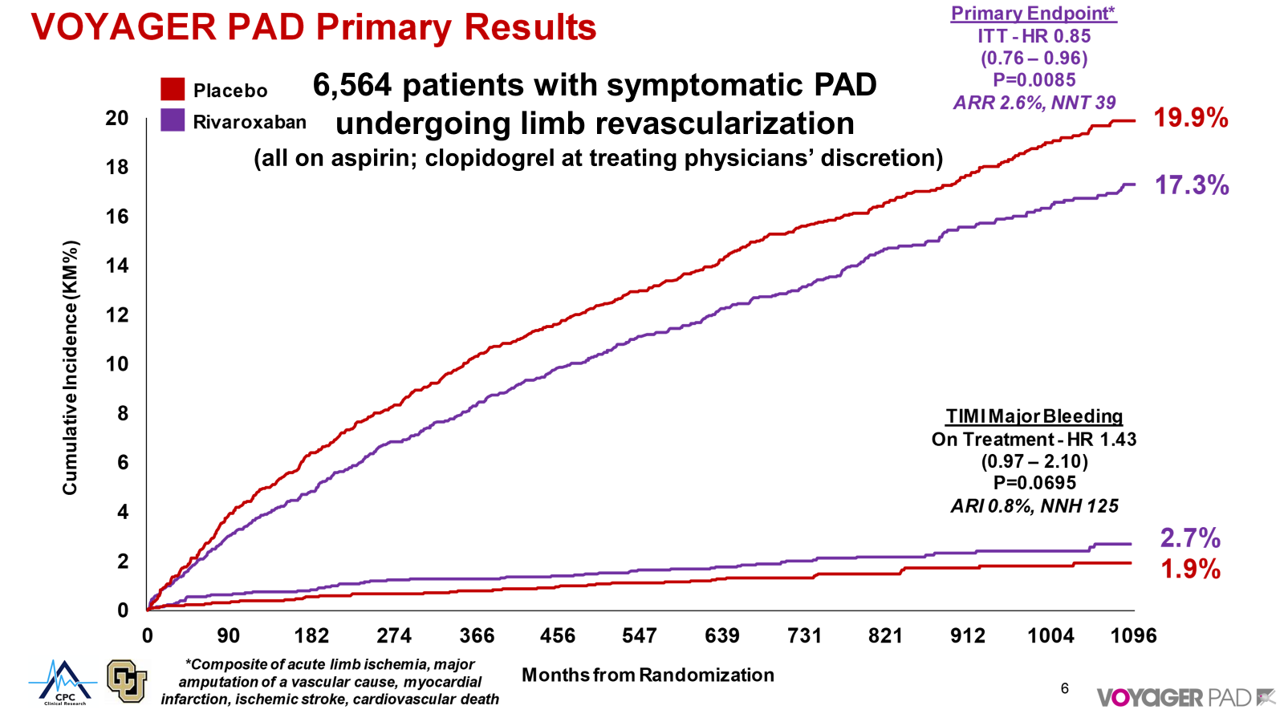
VOYAGER PAD: Background & Methods

Slide 3
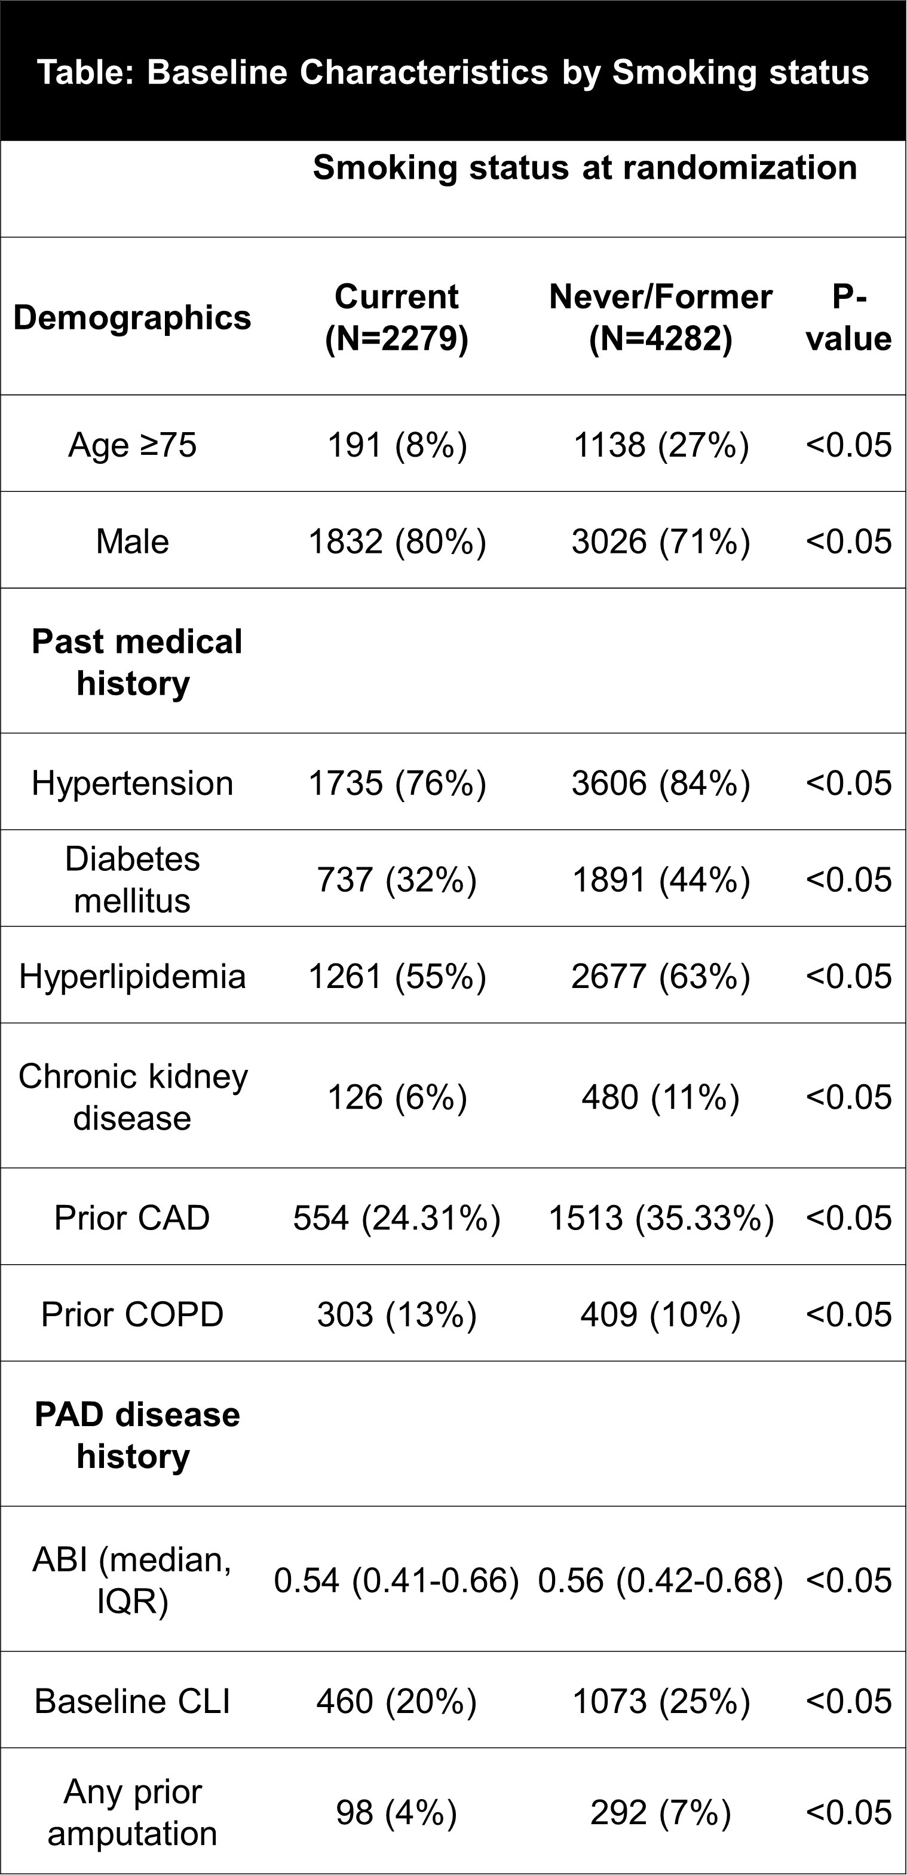
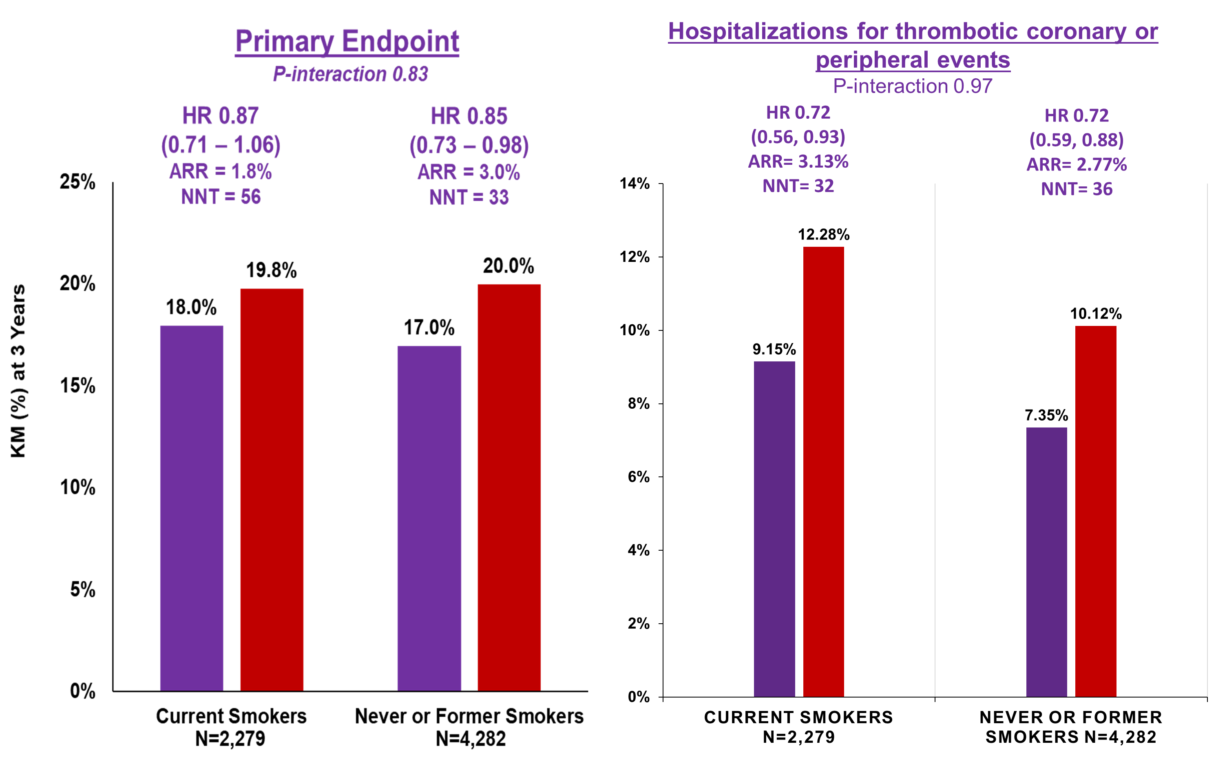
VOYAGER PAD: Results
Placebo
Rivaroxaban

Slide 4
Benefits of Rivaroxaban Are Consistent Regardless of DAPT
Placebo
Rivaroxaban
With Clopidogrel
N = 3,313
DAPT Only
18.3%
Question is no longer DAPT vs DPI but how long to continue DAPT & can stopping clopidogrel earlier reduce bleeding risk
DAPT + Rivaroxaban
Primary Efficacy Endpoint
16.0%
ISTH Major Bleeding
ARR 2.3%
ARI 0.4%
6:1 Benefit Risk Ratio for Adding Rivaroxaban on top of DAPT
Cumulative Incidence (KM%)
Principal Safety Outcome
2.7%
2.3%
Days from Randomization

Slide 5
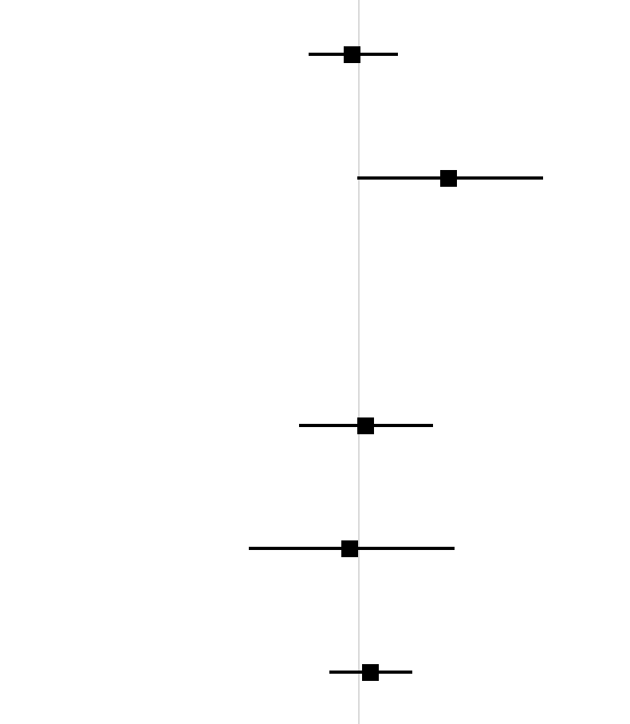
Additional 180-Day Outcomes With
DAPT vs SAPT
180-Day Outcome*
HR (95% CI)
p-value
Primary Efficacy Composite
0.96 (0.74-1.26)
0.78
TIMI Major/Minor Bleeding
1.71 (0.99-2.98)
0.056
Other Selected Outcomes*
Acute Limb Ischemia
1.04 (0.70-1.55)
0.84
Major Amputation
0.95 (0.52-1.76)
0.87
Unplanned Index Limb Revascularization
1.07 (0.84-1.37)
0.58
0.5
1.0
2.0
5.0
Clopidogrel better
Clopidogrel worse

Slide 6
VOYAGER PAD DAPT Findings in Context
Trial | Efficacy | Result | Safety | Result | Limitations
CASPAR¹ 851 Patients after surgical bypass | Graft occlusion or revascularization, amputation, death | HR 0.98 (95% CI 0.78-1.23), P = NS | Severe/moderate GUSTO bleeding | HR 2.84 (95% CI 1.32-6.08), P = 0.007 | Surgical bypass only
CHARISMA² (PAD subgroup) 3,096 patients with chronic PAD | MI, stroke, CV death | HR 0.85 (95% CI 0.66-1.08), P = 0.18 | Minor bleeding | OR 1.99 (95% CI 1.69-2.34), P = 0.001 | Subgroup with chronic PAD, no limb outcomes
MIRROR³ 80 patients after endovascular revascularization | Target lesion revascularization | 6 months: 5% vs 20%, P = 0.04 12 months: 25% vs 32%, P = 0.35 | Bleeding events | 6 months: 2.5% vs 5%, P = 0.56 | Small study, minimal number of events
VOYAGER PAD⁴ 6,564 Patients 4,624 in DAPT analysis >90% endo | ALI, major amputation of vascular etiology, MI, stroke, CV death | HR 0.96 (95% CI 0.74- 1.26), P = 0.78 | TIMI major/minor bleeding | HR 1.71 (95% CI 0.99-2.98), P = 0.056 | Clopidogrel use not randomized

