Slide 1
ACC.24 Integrating Complex Data Into Clinical Practice
SHASTA-2 Final Study Results
Daniel Gaudet, MD, PhD
Clinician Researcher, Lipidology, Professor of Medicine
University of Montreal, Montreal, Canada

Slide 2
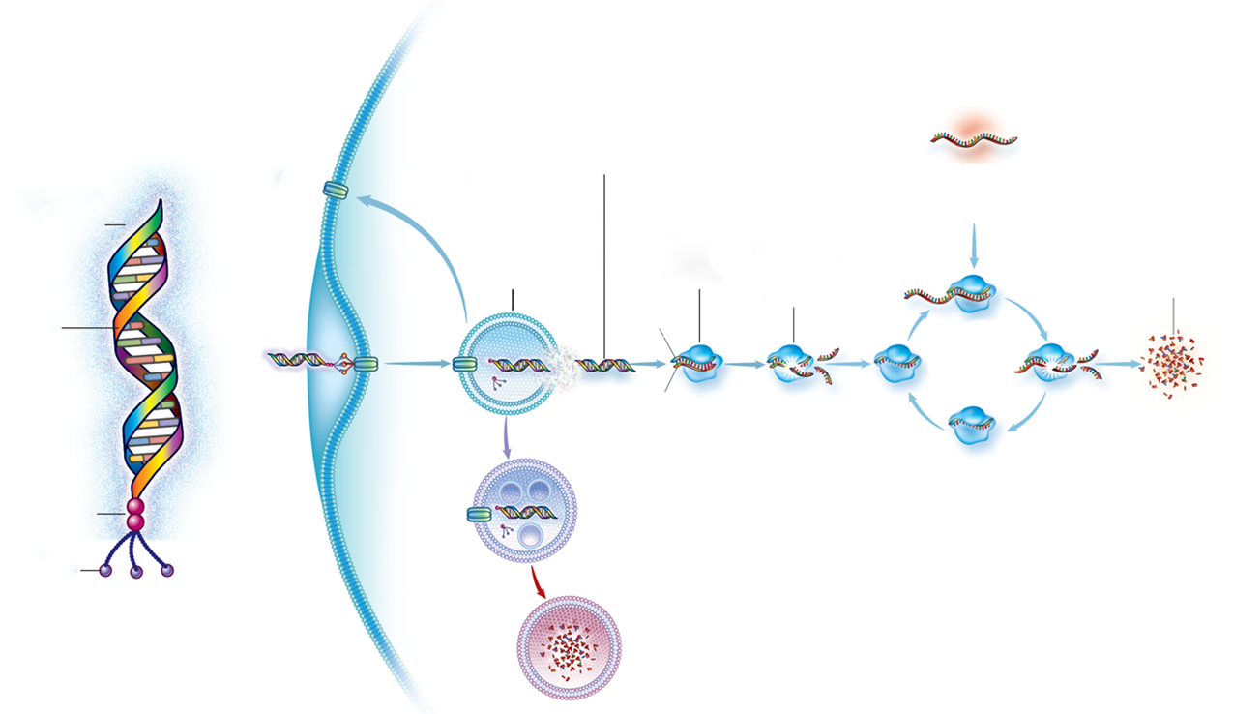

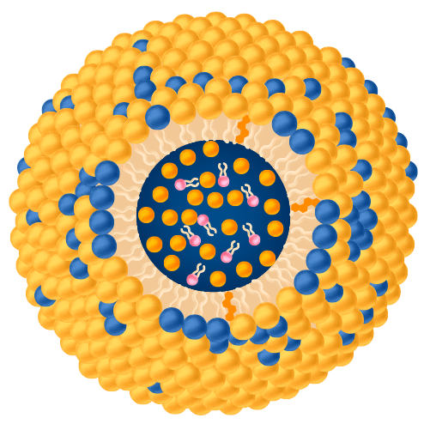
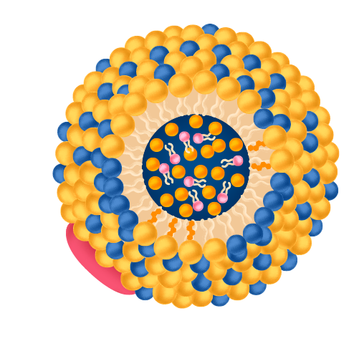
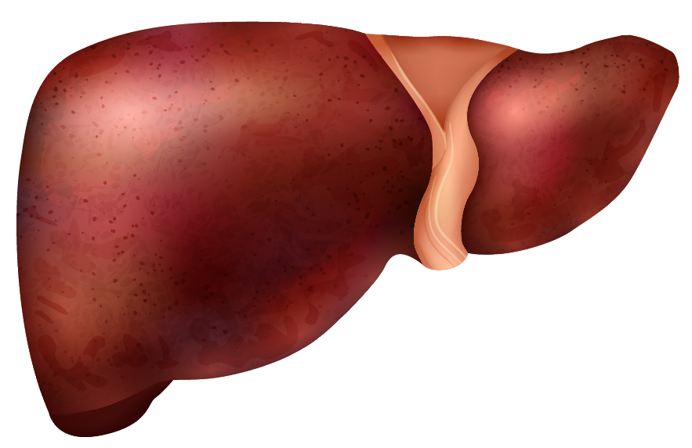


Key Features of Plozasiran RNAi Modality to Target APOC3, a Key Mediator of TG and Atherogenic Lipoproteins
RNAi is a natural process that uses
short fragments of RNA molecules to interfere with mRNA translation into associated proteins
Plozasiran is an RNAi targeting APOC3, accelerating TRL catabolism and
clearance through LPL-mediated and
LPL-independent mechanisms
mRNA
APOC3
Plozasiran
Receptor recycling
Endosomal escape
APOC3 Inhibits TRL Catabolism and Hepatic Clearance Leading to Increased TGs
Silencing of APOC3 Enables TRL Catabolism and Hepatic Clearance Leading to Reduced TGs
Stabilization chemistries
ASGPR
Sequence-specific pairing to target mRNA
Cellular uptake
RISC loading
Passenger strand cleavage
siRNA
conjugate
Guide strand
mRNA is degraded
Chylomicron
Chylomicron
APOC3 Inhibits TRL catabolism by LPL
VLDL
Increased TRL catabolism by LPL
siRNA
RISC complex remains active
VLDL
TRL
TRL
Passenger strand
Plozasiran
pH drop
LPL
LPL
Independent
LPL
Independent
LPL
Linker
chemistries
Late endosome
APOC3
APOC3
APOC3
APOC3
GalNac targeting ligands
TRL-Remnants
Hepatocyte
Cytoplasm
TRL-Remnants
siRNA is degraded
APOC3 inhibits TRL and
remnant clearance by inhibiting uptake by liver receptors
Increased TRL &
TRL remnant clearance
High Specificity
Potent Activity
Safety
Infrequent Dosing

Slide 3

SHASTA-2: A Double-Blind, Phase 2b, Placebo-Controlled, Dose-Ranging Study of Plozasiran in Subjects With SHTG
Study Objectives: To evaluate safety and efficacy for lowering TG and atherogenic lipoproteins in subjects with SHTG, and to explore optimal dosing
Study Population: SHTG history of
TG ≥ 500 mg/dL and fasting TG of 500 –
4,000 mg/dL during screening period
Key Endpoints*: % change from baseline and over time in:
  Primary Endpoint: TG at 24 weeks
  Key LP Parameters: APOC3, non-HDL-C, LDL-C, HDL-C, APOB, remnant cholesterol
  Safety
Data Analysis: Phase 2 study data evaluated at Week 24 and Week 48
All subjects were eligible to enroll in an open-label extension (OLE) at end of the study.
Randomization
Plozasiran 10 mg (N=54)
Screening/ Diet Run-In
≤ 6 weeks
Plozasiran 25 mg (N=55)
Plozasiran 50 mg (N=57)
Pooled Placebo (N=60)
Week
0
12
24
36
48
Doses
Every-3-Month SQ Dosing
EOS

Slide 4
Baseline Characteristics
 | Pooled Placebo (N = 60) | Plozasiran
 | (N=60) | 10 mg (N = 54) | 25 mg (N = 55) | 50 mg (N = 57)
Mean (SD) age, years | 56 (11) | 53 (10) | 56 (11) | 54 (11)
Female, n (%) | 14 (23) | 8 (15) | 12 (22) | 16 (28)
White, n (%) | 55 (92) | 47 (87) | 48 (87) | 53 (93)
Mean (SD) BMI, kg/m² | 31 (4) | 33 (5) | 32 (5) | 32 (5)
Mean (SD) APOC3,ª mg/dL | 31 (16) | 33 (15) | 34 (17) | 32 (16)
Median (Q1, Q3) triglyceride, mg/dL | 679 (540, 929) | 696 (559, 1088) | 598 (517, 982) | 663 (531, 1028)
Mean (SD) triglyceride, mg/dL | 851 (507) | 890 (577) | 942 (756) | 908 (653)
Mean (SD) non-HDL-C, mg/dL | 185 (79) | 209 (74) | 206 (91) | 196 (88)
Mean (SD) ApoB, mg/dL | 95 (29) | 103 (44) | 103 (32) | 110 (55)
Mean (SD) remnant cholesterol,^{b} mg/dL | 115 (82) | 134 (88) | 132 (98) | 124 (92)
Mean (SD) LDL-C, UC, mg/dL | 69 (39) | 75 (44) | 74 (40) | 72 (42)
Mean (SD) HDL-C, mg/dL | 30 (12) | 28 (9) | 30 (11) | 31 (13)

Slide 5
Plozasiran Demonstrates Significant Decreases in APOC3 and Contributes to Restoration of Triglyceride Homeostasis
~70% Decrease
LS Mean*ª % Change from Baseline at Week 24 & 48
Week 24 | -1% | -69% P < 0.0001 | -72% P < 0.0001 | -78% P < 0.0001
Week 48 | 4% | -34% P < 0.0001 | -48% P < 0.0001 | -47% P < 0.0001
LS Mean* % Change from Baseline at Week 24 & 48
Week 24 | -17% | -66% P < 0.0001 | -70% P < 0.0001 | -74% P < 0.0001
Week 48 | -7% | -31% P < 0.05 | -58% P < 0.0001 | -53% P < 0.0001
Placebo
Plozasiran 10 mg
Plozasiran 25 mg
Plozasiran 50 mg

Slide 6
Plozasiran Demonstrates Significant Decreases in APOC3 and Contributes to Restoration of Triglyceride Homeostasis
Plozasiran decreases LS mean serum APOC3, TGs, and remnant cholesterol while increasing HDL-C at 24 weeks (persisting at 48 weeks) for all dose levels:
At 24 weeks over 90% of subjects treated with plozasiran achieved TGs < 500 mg/dL and below the risk threshold for acute pancreatitis
Half of subjects reached values below 150 mg/dL
Plozasiran has a favorable safety profile at 48 weeks
These data support further development of plozasiran in planned phase 3 programs for the treatment of chylomicronemia and SHTG
Based on these results, RNAi-mediated silencing of hepatic APOC3 expression via plozasiran is a promising potential treatment for subjects with SHTG
  APOC3 to -78%, (-48%)
  TG to -74%, (-58%)
  Remnant cholesterol to -62%, (-45%)
  HDL-C up to +68%, (+38%)

